Slide 1
Virtual Memory

Slide 2
Virtual Memory
Virtual memory is a feature of an operating system that enables a computer to be able to compensate shortages of physical memory by transferring pages of data from random access memory to disk storage.
This process is done temporarily and is designed to work as a combination of RAM and space on the hard disk.
Virtual Memory is a space where large programs can store themselves in form of pages while their execution and only the required pages or portions of processes are loaded into the main memory. This technique is useful as a large virtual memory is provided for user programs when a very small physical memory is there. Thus Virtual memory is a technique that allows the execution of processes that are not in the physical memory completely.
Virtual Memory mainly gives the illusion of more physical memory than there really is with the help of Demand Paging.

Slide 3
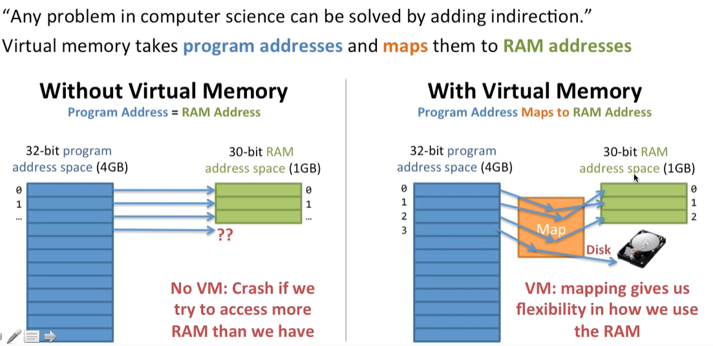

Slide 4
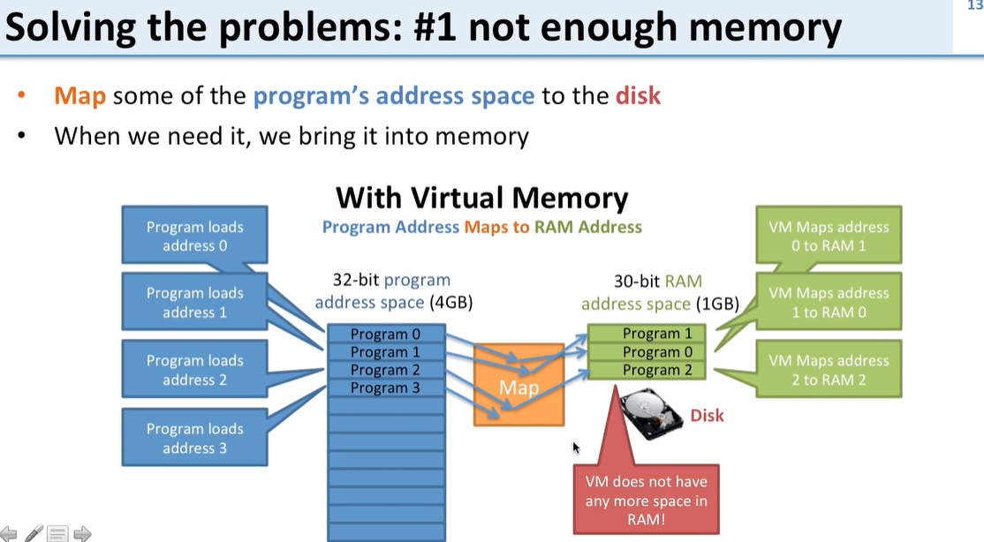

Slide 5
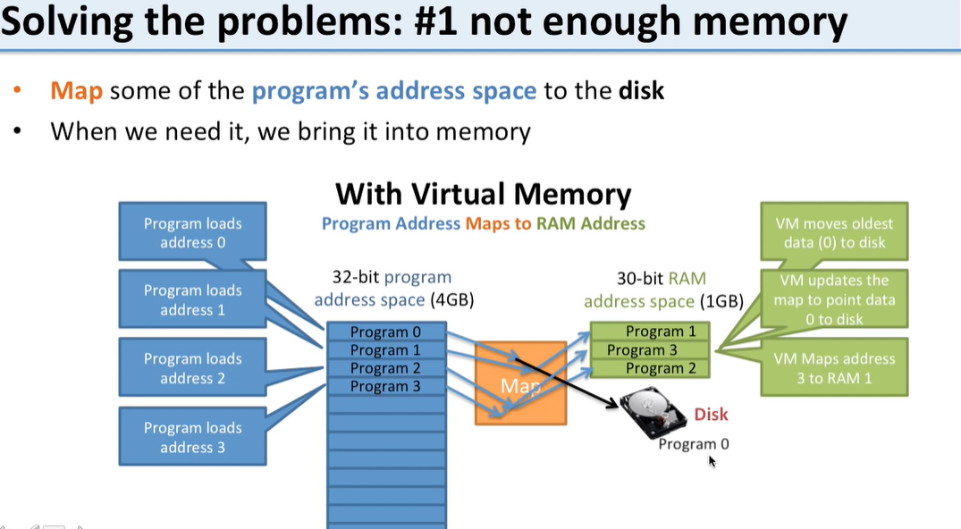

Slide 6
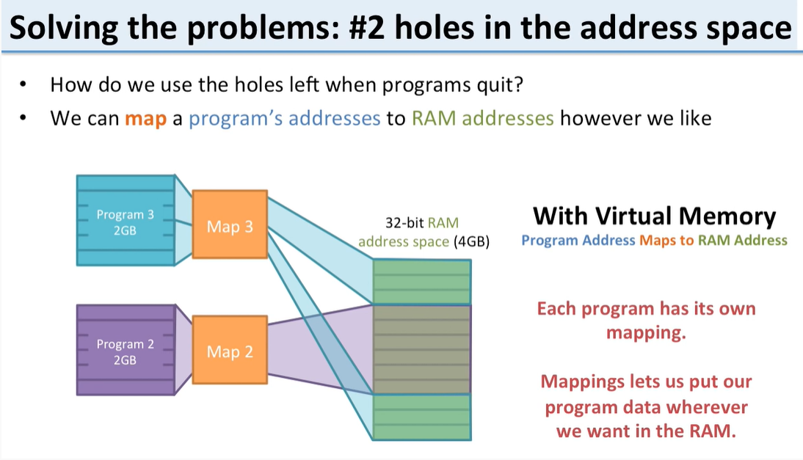

Slide 7
Need of Virtual Memory
Main objective of needing is virtual memory is to increase the storage space of running memory, without adding any external memory such as RAM (Random Access Memory).
If, any time computer’s physical memory is totally occupied for other programs, but same time it needs to some extra memory then requests are forwarded to hard disk for swapping files like as virtual memory.
If, any time computer requires the extra more main memory (RAM), then it try to install in the machine, and it works as small area of disk for fulfill system needs.

Slide 8
Demand paging
Demand paging is a process of swapping in the Virtual Memory system.
In this process, all data is not moved from hard drive to main memory because while using this demand paging, when some programs are getting demand then data will be transferred.
But, if required data is already existed into memory then not need to copy of data.
The demand paging system is done with swapping from auxiliary storage to primary memory, so it is known as “Lazy Evaluation”.

Slide 9
Demand Paging is a technique in which a page is usually brought into the main memory only when it is needed or demanded by the CPU.
Initially, only those pages are loaded that are required by the process immediately.
Those pages that are never accessed are thus never loaded into the physical memory.
The demand paging system is somehow similar to the paging system with swapping where processes mainly reside in the main memory(usually in the hard disk). Thus demand paging is the process that solves the above problem only by swapping the pages on Demand. This is also known as lazy swapper( It never swaps the page into the memory unless it is needed).
Swapper that deals with the individual pages of a process are referred to as Pager.

Slide 10
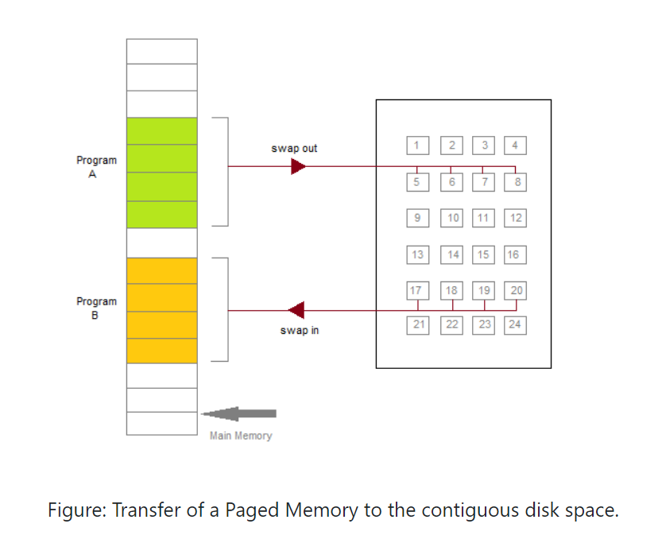

Slide 11
Valid-Invalid Bit
With each page table entry, a valid-invalid bit is associated( where 1 indicates in the memory and 0 indicates not in the memory)
Initially, the valid-invalid bit is set to 0 for all table entries.
If the bit is set to "valid", then the associated page is both legal and is in memory.
If the bit is set to "invalid" then it indicates that the page is either not valid or the page is valid but is currently not on the disk.
During the translation of address, if the valid-invalid bit in the page table entry is 0 then it leads to page fault.

Slide 12
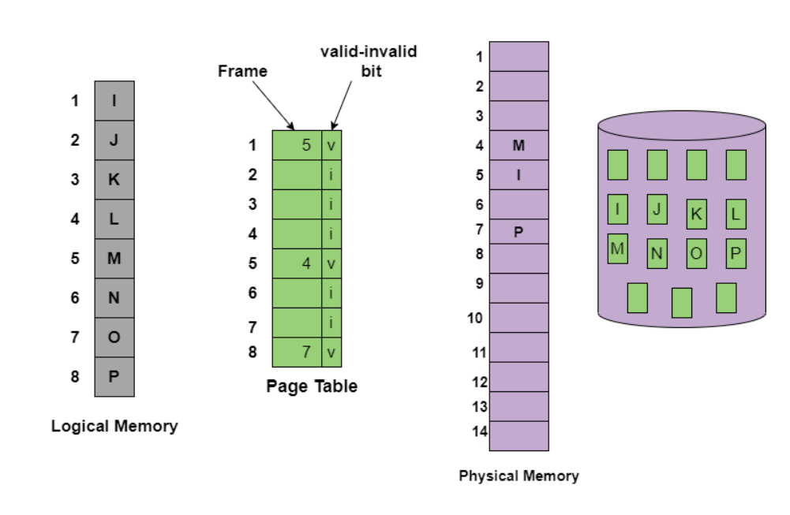
The above figure is to indicates the page table when some pages are not in the main memory.

Slide 13
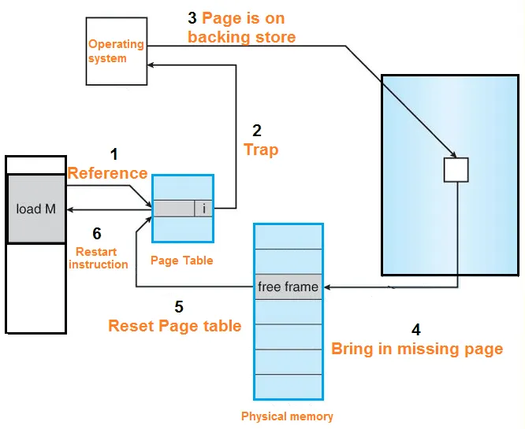
Demaind paging process

Slide 14
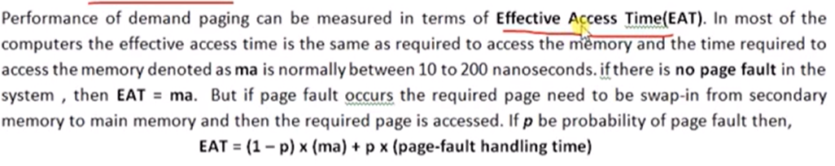
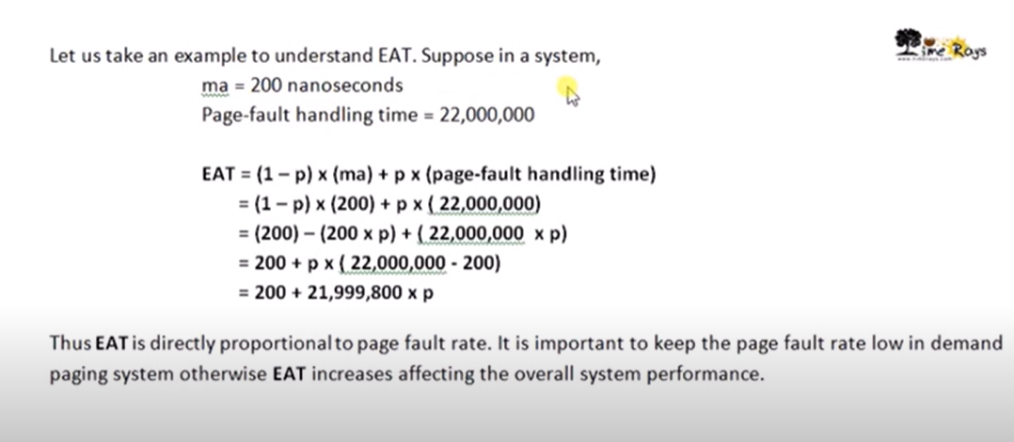
Performance of EAT with Numerical

Slide 15
Numerical 2
Memory Access Time=200ns
Page fault service time= 8ms=8,000,000
Effective Access Time=?
EAT= (1-p) (memory access) + p (Page Fault Handling Time)
(1-p) * 200 + p * (8,000,000)
= (1-p) * 200 + p * 8,000,000
= 200 -200p+ 8,000,000 * p
=200+p(8,000,000-200)
200 + p7999,800
Here, p=1/1000
200+7999,800/1000
200+ 7999.8
8199.8
convert into microsecond
8199.8/1000
8.1998= 8.2 microsecond

Slide 16
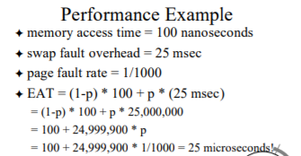
Numerical 3

Slide 17
What is a Page Fault?
If the referred page is not present in the main memory then there will be a miss and the concept is called Page miss or page fault.
The CPU has to access the missed page from the secondary memory. If the number of page fault is very high then the effective access time of the system will become very high.
What is Thrashing?
If the number of page faults is equal to the number of referred pages or the number of page faults are so high so that the CPU remains busy in just reading the pages from the secondary memory then the effective access time will be the time taken by the CPU to read one word from the secondary memory and it will be so high. The concept is called thrashing.
If the page fault rate is PF %, the time taken in getting a page from the secondary memory and again restarting is S (service time) and the memory access time is ma then the effective access time can be given as;
EAT = PF X S + (1 - PF) X (ma)

